Slide 1

DF
LECTURE
Windows Artifacts
Diploma in CSF/IT
Year 2/3 (2022/23), Semester 4/6
Digital Forensics
4
Notes:
Left-hand Bar – Replace FSP by your module code and X by the lecture number.
Replace Lecture Title
Replace < Module Name >
Replace Year and Semester if necessary

Slide 2
Objectives
At the end of this, you will get to know more about:
Windows system files and folders
Windows user files and folders
Root Folder
Recycle Bin
Low folder
Cookies Folder
Temporary Internet Files
History/Favorites Folder
Email Folder
Skype Folder
Recent Folder
My Documents
Sent To Folder
Temp Folder
Desktop Folders

Slide 3
Default New Installation System Folder and User Profile Folder Names
Folder structure of a Windows OS can provide evidence by itself.
By looking at the directory structure, examiners should be able to determine the Windows version.
Navigating and locating operating system artifacts is important to examiners and we should be familiar with the Windows directory structure for each versions.
rmb
Operating System | Default System Folder | User Profile Folders
Windows 2000 | C:\WINNT | C:\Documents and Settings
Windows XP | C:\Windows | C:\Documents and Settings
Windows Vista/7/8/10 | C:\Windows | C:\Users

Slide 4
User Files and Folders
A series of folders and files is created whether the person logs on locally or authenticates through the network.

Slide 5
Root Folder
The Root folder is named after the user’s login name.
Folders containing the user’s documents, configuration and environment data are created as subfolders under root folder.
Application Data
Cookies
Desktop
Favorites
Etc.

Slide 6
NTUSER.DAT in Root Folder
Every user profile created on a Windows operating system has an NTUSER.DAT file. A user profile contains personal files and preference settings that are specific to each user.
The NTUSER.DAT file is a registry file. Each user's NTUSER.DAT file contains the registry settings for their individual account.
This file is updated by the operating system when the user logs out.
Last written time can be used to possibly determine when the user last logged out.
A registry viewer is required to view registry hives such as NTUSER.DAT.

Slide 7
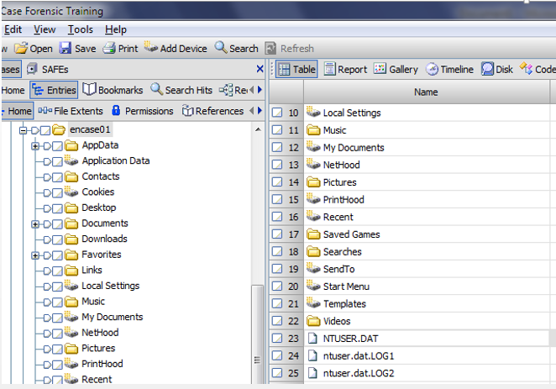
NTUSER.DAT in Root Folder – cont.
Root folder

Slide 8
Recycle Bin
By default, when a user deletes a file in Windows, the file is placed in the Recycle Bin.
In Windows 2000/XP, the deleted files original file name and path, date and time of deletion are stored in a hidden file called INFO2.

Slide 9
Recycle Bin – cont.
In Windows Vista/7/8/10, no more INFO2 file and renaming the deleted files/folders.
Individual index files that begin with $I
$I<number>.<original extension>
Deleted file name is renamed and begins with $R
$R<number>.<original extension>
Recycle bin is located at C:\Users\%UserName%\$RECYCLE.BIN\<SID>
SID: Security Identifier

Slide 10
Recycle Bin – cont.
Read more on http://en.wikipedia.org/wiki/Recycle_Bin_(Windows)
Operating System | Recycle Bin Folder Name | INFO2 Record Length
Windows 2000/XP | Recycler | 800
Windows Vista/7/8/10/11 | $Recycle.bin | No INFO2 file

Slide 11
Low Folders
Presence of low folders in
Cookies folder
Temporary Internet Files folder
History folder
Microsoft use it to protect system against malware (hence only presence in Internet Explorer).
Data placed in the low folder runs at the lowest possible level privilege.
Examiners must access into both the normal and low folders to have a complete investigation.
Notes:
In Windows Vista, Internet Explorer 7 runs in Protected Mode, which helps protect users from attack by running the Internet Explorer process with greatly restricted privileges. Protected Mode significantly reduces the ability of an attack to write, alter, or destroy data on the user's machine or to install malicious code.
The Low integrity level is the level used by default for interaction with the Internet. As long as Internet Explorer is run in its default state, Protected Mode, all files and processes associated with it are assigned the Low integrity level. Some folders, such as the Temporary Internet Folder, are also assigned the Low integrity level by default.
Protected Mode can be configured in Internet Explorer's Internet Options dialog. To configure Protected Mode, click the Security tab, select a Web content zone, and then change the Enable Protected Mode check box. By default, Protected Mode is enabled for the Internet, Intranet, and Restricted Sites zones. To verify that Internet Explorer is running in Protected mode, look for the words "Protected Mode: On" next to the Web content zone displayed in Internet Explorer's status bar.

Slide 12
Cookies Folder
Cookie is a piece of text stored on a user's computer by their web browser.
It is created by websites and placed on user’s computer.
A cookie can be used for
Authentication
Storing site preferences
Shopping cart contents
The identifier for a server-based session

Slide 13
Cookies Folder – cont.
Cookie names – user name@domain name.txt
Each cookie is contained in 1 file.
The total collection of cookie files is under the management of index.dat, which contains data about each cookie and pointers to the cookie file to the originating web domain name.
The index.dat file contains dates, and the cookie itself contains internal dates.
The internal dates of a cookie describe when it was last modified by the website and its expiration date.

Slide 14
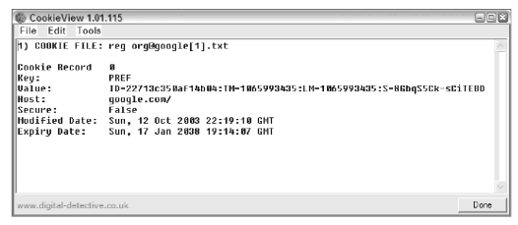
Cookies Folder – cont.
To interpret cookies, forensic examiner may use cookie decoder such as CookieView, which works well with Encase.

Slide 15
Temporary Internet Files (TIF)
Mainly for Internet Explorer.
Store files that are downloaded and cached from the Internet.
Useful to track user’s web browsing history, including web mail (Gmail).
For earlier Windows OS :
C:\Users\%UserName%\AppData\Local\Microsoft\Windows\ Temporary Internet Files\
For Windows 10 :
C:\Users\%UserName%\AppData\Local\Microsoft\Windows\ INetCache\

Slide 16
Internet Explorer
Favorites, History are located in:
C:\Users\%UserName%\Favorites
C:\Users\%UserName%\AppData\Local\Microsoft\Windows\History
History.IE5
Low\History.IE5 – contains Internet data resulting from browsing in the protected mode
Cookies are located in:
C:\Users\%UserName%\AppData\Roaming\Microsoft\Windows\Cookies
C:\Users\%UserName%\AppData\Roaming\Microsoft\Windows\Cookies\Low - for applications running under low privilege

Slide 17
Other browsers – Google Chrome
Bookmarks, History, Cookies are located in:
C:\Users \%UserName%\ AppData\Local\Google\Chrome\ User Data\Default\
These files use SQLite database format.

Slide 18
Other browsers - Mozilla Firefox
Bookmarks, History are located in:
C:\Users \%UserName%\AppData\Roaming\mozilla\Firefox\ Profiles\xx.default\places.sqlite
Cookies are located in:
C:\Users \%UserName%\AppData\Roaming\mozilla\Firefox\ Profiles\xx.default\cookies.sqlite

Slide 19
Email Folder
Windows 10 comes with a Windows Mail application.
C:\Users\%UserName%\AppData\Local\Comms\Unistore\data\
Windows 11
C:\Users\username\AppData\Local\Microsoft\Windows Mail

Slide 20
Online Communication Tools - Skype, MS Team
Skype client store the instant messaging history in:
C:\Users\%UserName%\AppData\Roaming\Skype\<aliases>\main.db
MS Team client store the conversations in:
Office 365 Group Mailbox, in a hidden folder called Conversation History\Team Chat. Private chats are stored in the posting user's mailbox, in a hidden folder called Conversation History\Team Chat.

Slide 21
Recent Folders
C:\Users\%UserName%\AppData\Roaming\Microsoft\Windows\Recent
Contains link files that links to recently accessed files, folders, and applications.

Slide 22
My Documents
Default location where all compliant applications store user-generated data.
From Windows Vista onwards, this folder is renamed as Documents folder.
C:\Users\%UserName%\Documents

Slide 23
Sent To Folder
Contains within this folder are the options that a user has when the user right-click on an object and choose Send To.
Default selections include Documents, Mail Recipient, Desktop and the drives.
Installed applications may add additional options to this folder and the user has the ability to create entries as well.
C:\Users\%UserName%\AppData\Roaming\Microsoft\Windows\SendTo

Slide 24
Temp Folder
Contains temporary files created by Windows as various programs are running and different processes are taking place.
They are often exact copies of files stored elsewhere on the computer. At other times they are exact duplicates of files which are waiting their turn to be processed by the computer.

Slide 25
Temp Folder – cont.
For example, a print job going to a laser printer will create a temporary file called an EMF (enhanced windows metafiles). EMF's (miniature pictures of the original) can often be found in the Temp directory months after laser printer was used. Many other kinds of files can be found in the Temp directory as well (e.g., automatic document recovery files).
C:\Users\%UserName%\AppData\Local\Temp

Slide 26
Desktop Folder
Contains items that populate the user’s Desktop.
Items within this folder are those that the user has intentionally placed or those which applications have generated during installation.
Desktop folder of All Users account must be evaluated as well as any items present within the All Users Desktop folder can appear on the Desktop of the specific user.
In Windows Vista onwards, the All Users folder has been replaced with a folder called “Public”.
C:\Users\%UserName%\Desktop

Slide 27
Summary
It is important to evaluate through the entire Windows directory to do a full investigation.
Understanding the various locations of important folders/files in different versions of Windows is an essential knowledge of an investigator.

Slide 28
Reference Books
The Official EnCase Certified Examiner Study Guide, Second Edition, Steve Bunting, Guidance Software
EC-Council, Computer Hacking Forensic Investigator.
Guidance Software, Inc, EnCase Computer Forensics I & II.
Jason T. Luttgens, Matthew Pepe, Kevin Mandia, Incident Response & Computer Forensics (3rd Edition), McGraw-Hill Education
Notes:
Publisher: Cisco Press, Thomson Learning

